Slide 1
More on HTML
Dr. Gaganpreet Kaur
Department of Computer Science and Engineering
Chitkara University, Punjab

Slide 2
The <div> tag
The <div> tag defines a division or a section in an HTML document.
The <div> tag is used as a container for HTML elements - which is then styled with CSS or manipulated with JavaScript.
The <div> tag is easily styled by using the class or id attribute.

Slide 3
<!DOCTYPE html>
<html>
<head>
<style>
.myDiv {
border: 5px outset black;
background-color: lightgreen;
text-align: center;
}
</style>
</head>
<body>
<h1>The div element</h1>
<div class="myDiv">
<h2>This is a heading in a div element</h2>
<p>This is some text present in a div element.</p>
</div>
<p>This is text outside the div element.</p>
</body>
</html>
A <div> section in a document that is styled with CSS:

Slide 4
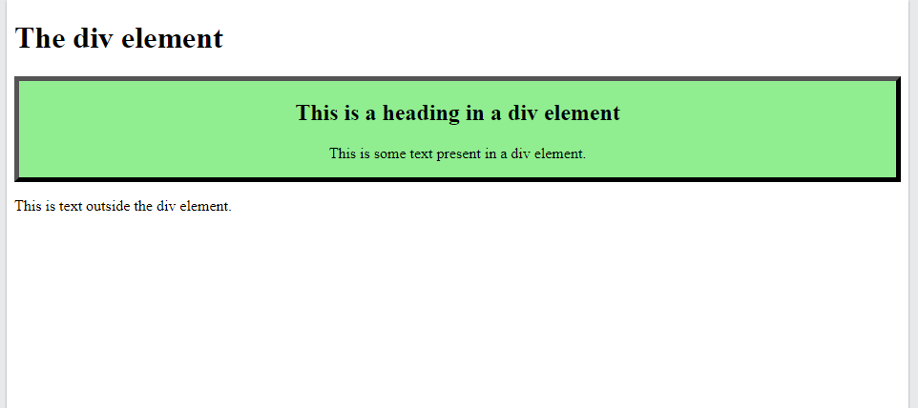

Slide 5
Block-level Elements
A block-level element always starts on a new line, and the browsers automatically add some space (a margin) before and after the element.
A block-level element always takes up the full width available (stretches out to the left and right as far as it can).
Two commonly used block elements are: <p> and <div>.
The <p> element defines a paragraph in an HTML document.
The <div> element defines a division or a section in an HTML document.

Slide 6
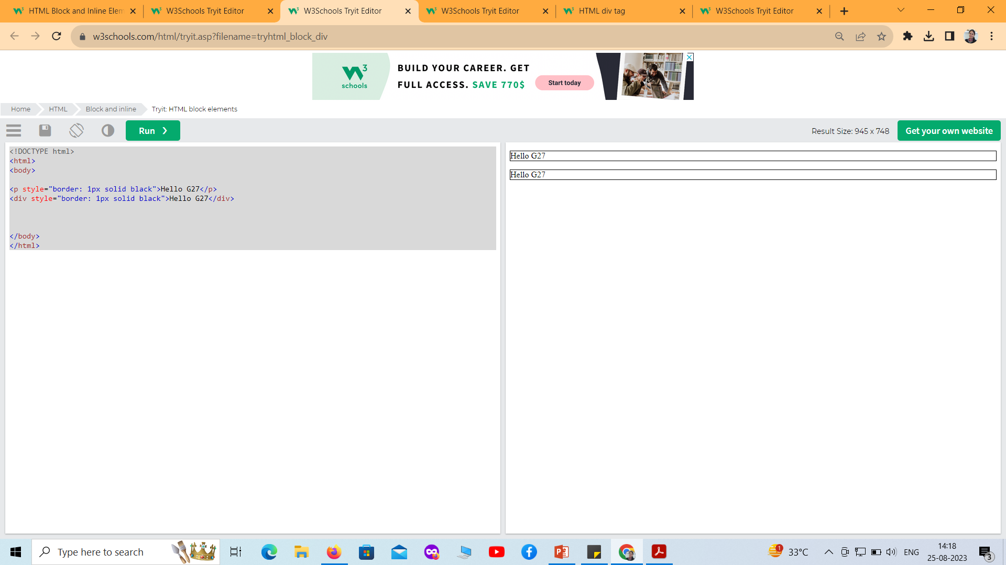
<!DOCTYPE html>
<html>
<body>
<p style="border: 1px solid black">Hello G27</p>
<div style="border: 1px solid black">Hello G27</div>
</body>
</html>

Slide 7
Inline Elements
An inline element does not start on a new line.
An inline element only takes up as much width as necessary
<!DOCTYPE html>
<html>
<body>
<p>This is an inline span <span style="border: 1px solid black">Hello World</span> element inside a paragraph.</p>
</body>
</html>
Output
This is an inline span Hello World element inside a paragraph.

Slide 8
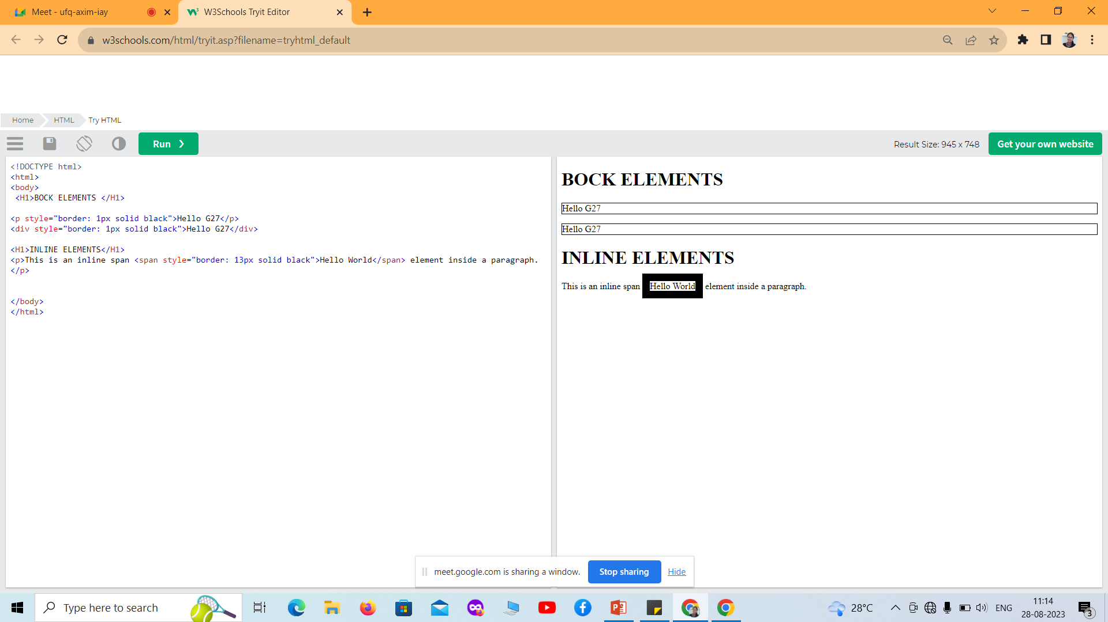

Slide 9
Text Formatting Tags
Formatting elements were designed to display special types of text:
<b> - Bold text
<strong> - Important text
<i> - Italic text
<em> - Emphasized text
<mark> - Marked text
<small> - Smaller text
<del> - Deleted text
<ins> - Inserted text
<sub> - Subscript text
<sup> - Superscript text

Slide 10
Text Formatting Tags: Example
<!DOCTYPE html>
<html>
<body>
<p>This text is normal.</p>
<p><b>This text is bold.</b></p>
</body>
</html>

Slide 11
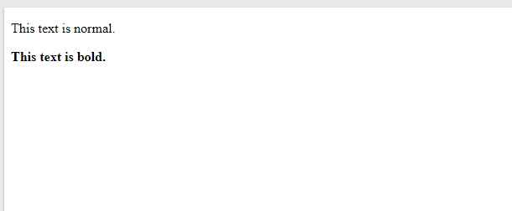
Text Formatting Tags: Example

Slide 12
HTML Quotation and Citation Elements
Tag | Description
<abbr> | Defines an abbreviation or acronym
<address> | Defines contact information for the author/owner of a document
<bdo> | Defines the text direction
<blockquote> | Defines a section that is quoted from another source
<cite> | Defines the title of a work
<q> | Defines a short inline quotation

Slide 13
<abbr> Tag
HTML <abbr> for Abbreviations
The HTML <abbr> tag defines an abbreviation or an acronym, like "HTML", "CSS", "Mr.", "Dr.", "ASAP", "ATM".
Marking abbreviations can give useful information to browsers, translation systems and search-engines.

Slide 14
<abbr> Tag
<!DOCTYPE html>
<html>
<body>
<p>The <abbr title="World Health Organization">WHO</abbr> was founded in 1948.</p>
<p>Marking up abbreviations can give useful information to browsers, translation systems and search-engines.</p>
</body>
</html>

Slide 15
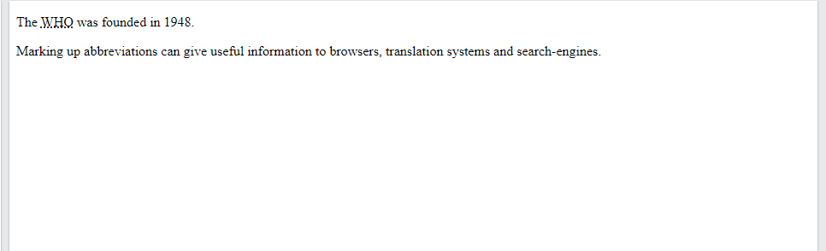
<abbr> Tag

Slide 16
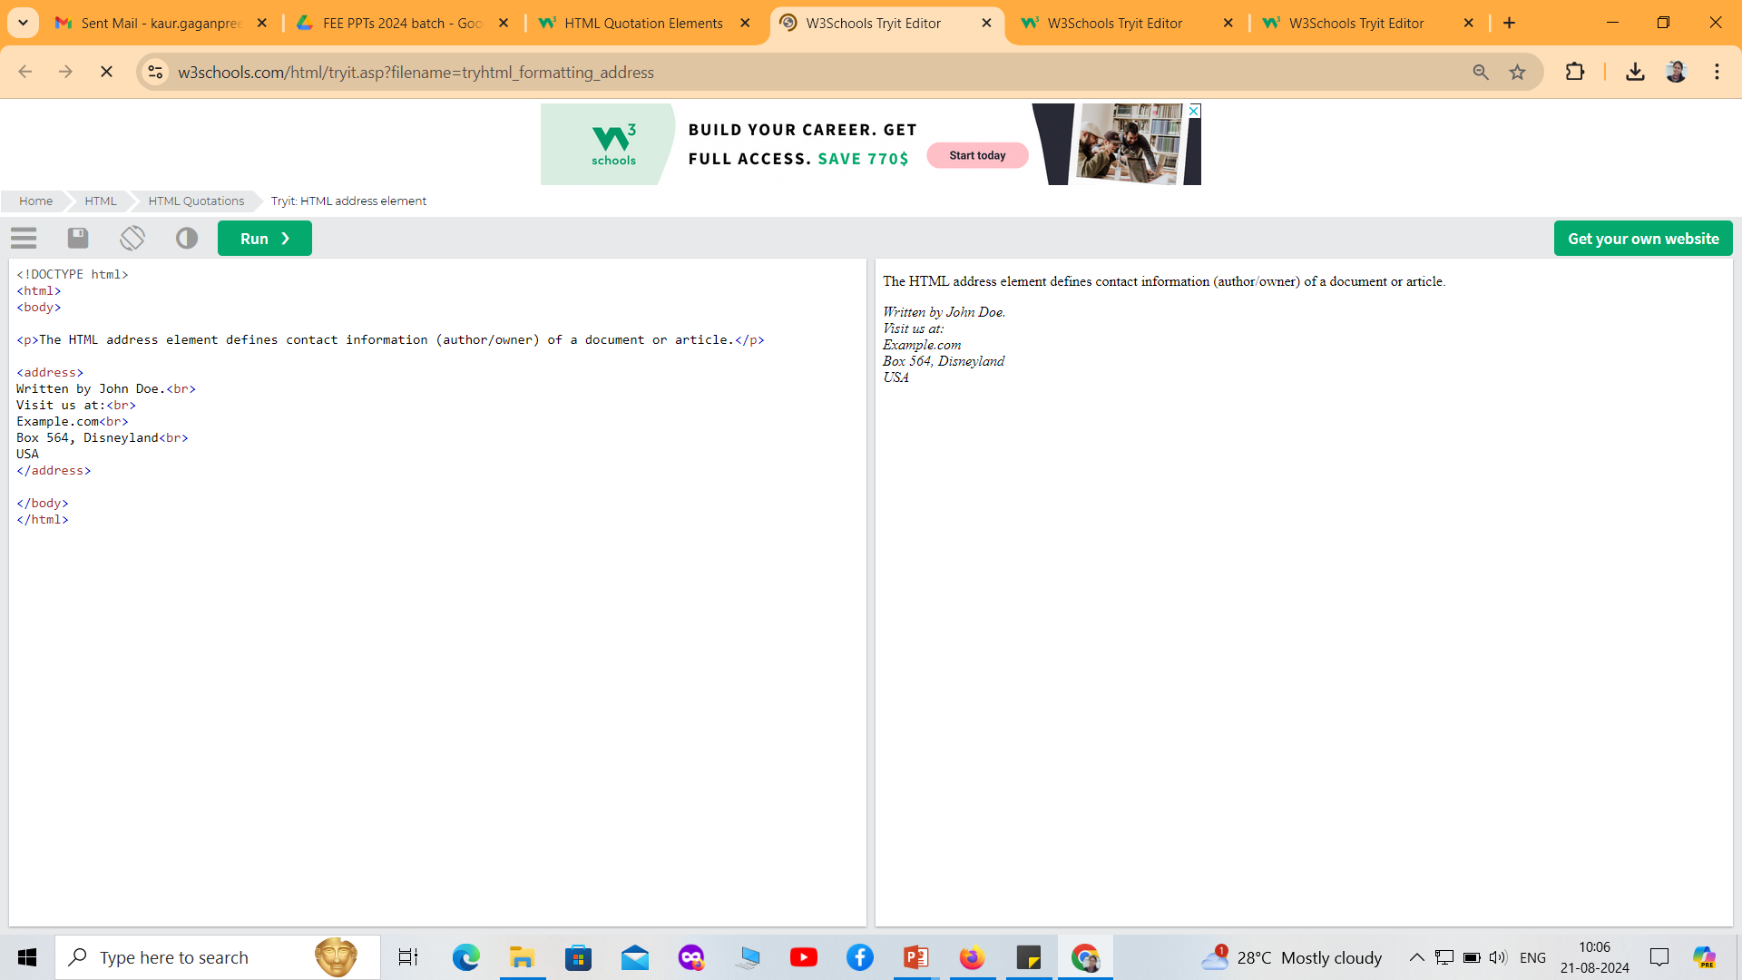
<address> Tag
The HTML <address> tag defines the contact information for the author/owner of a document or an article.
The contact information can be an email address, URL, physical address, phone number, social media handle, etc.

Slide 17
HTML Semantic Elements
What are Semantic Elements?
A semantic element clearly describes its meaning to both the browser and the developer.
Examples of non-semantic elements: <div> and <span> - Tells nothing about its content.
Examples of semantic elements: <form>, <table>, and <article> - Clearly defines its content.

Slide 18
HTML Hyper Links
HTML links are hyperlinks.
You can click on a link and jump to another document.
When you move the mouse over a link, the mouse arrow will turn into a little hand.
Note: A link does not have to be text. A link can be an image or any other HTML element!
HTML Links - Syntax
The HTML <a> tag defines a hyperlink. It has the following syntax:
<a href="url">link text</a>
The most important attribute of the <a> element is the href attribute, which indicates the link's destination.
The link text is the part that will be visible to the reader.
Clicking on the link text, will send the reader to the specified URL address.
<a> is called anchor tag

Slide 19
<!DOCTYPE html>
<html>
<body>
<h1>HTML Links</h1>
<p><a href="https://www.google.co.in/">Visit Google !</a></p>
</body>
</html>

Slide 20
Absolute URLs vs. Relative URLs
Both examples above are using an absolute URL (a full web address) in the href attribute.
A local link (a link to a page within the same website) is specified with a relative URL (without the "https://www" part):

Slide 21
<!DOCTYPE html>
<html>
<body>
<h2>Absolute URLs</h2>
<p><a href="https://www.google.com/">Google</a></p>
<h2>Relative URLs</h2>
<p><a href="html_images.asp">HTML Images</a></p>
<p><a href="/css/default.asp">CSS Tutorial</a></p>
</body>
</html>

Slide 22
TABLE TAGS

Slide 23
HTML <table> Tag
An HTML table consists of one <table> element and one or more <tr>, <th>, <td> elements.
The <tr> element defines a table row,
the <th> element defines a table header,
and the <td> element defines a table cell.

Slide 24
Example
<!DOCTYPE html>
<html>
<head>
<style>
bordertable, th, td {
: 1px solid black;
}
Th, td {
Padding: 10px;
}
</style>
</head>
<body>

Slide 25
Example
<h1>The table element</h1>
<table style = “width:500px”>
<table style = “background-color:#000000”>
<table style = “float:right”>
<tr>
<th>Month</th>
<th>Savings</th>
</tr>
<tr>
<td>January</td>
<td>$100</td>
</tr>
<tr>
<td>February</td>
<td>$80</td>
</tr>
</table>
</body>
</html>
Month | Savings
January | $100
Feb | $80

Slide 26
HTML <caption> Tag
The <caption> tag defines a table caption.
The <caption> tag must be inserted immediately after the <table> tag.

Slide 27
<!DOCTYPE html>
<html>
<head>
<style>
table, th, td {
border: 1px solid black;
}
body
{
background-image: url('image.jpg');
}
</style>
</head>
<body>
<table>
<caption style="text-align:right">My savings</caption>
<tr>
<th>Month</th>
<th>Savings</th>
</tr>
<tr>
<td>January</td>
<td>$100</td>
</tr>
</table>
<br>

Slide 28
<table>
<caption style="caption-side:bottom">My savings</caption>
<tr>
<th>Month</th>
<th>Savings</th>
</tr>
<tr>
<td>January</td>
<td>$100</td>
</tr>
</table>
</body>
</html>

Slide 29
HTML <colgroup> Tag
The <colgroup> tag specifies a group of one or more columns in a table for formatting.
The <colgroup> tag is useful for applying styles to entire columns, instead of repeating the styles for each cell, for each row.
Note: The <colgroup> tag must be a child of a <table> element, after any <caption> elements and before any <thead>, <tbody>, <tfoot>, and <tr> elements.

Slide 30
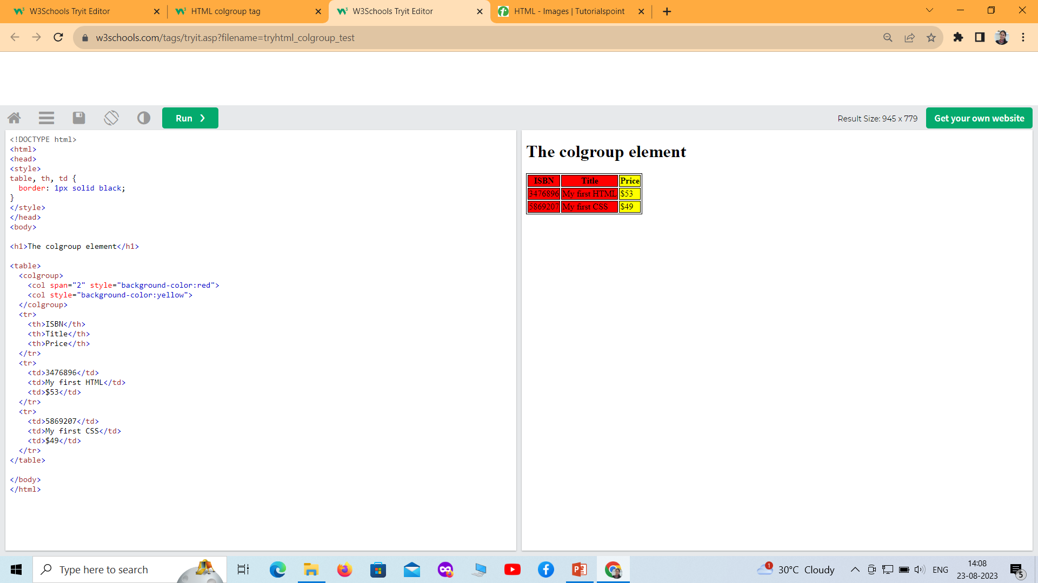

Slide 31
How To Add a Border
To add a border, use the CSS border property on table, th, and td elements:
table, th, td { border: 1px solid black; }
Collapse Borders
table, th, td { border: 1px solid black; border-collapse: collapse; }

Slide 32
HTML Table - Cell Padding
Cell padding is the space between the cell edges and the cell content.
By default the padding is set to 0.
To add padding on table cells, use the CSS padding property:
Example
th, td {
padding: 15px;
}

Slide 33
HTML Table - Cell Spacing
Cell spacing is the space between each cell.
By default the space is set to 2 pixels.
To change the space between table cells, use the CSS border-spacing property on the table element:
Example
table {
border-spacing: 30px;
}

Slide 34
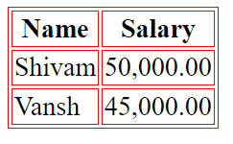
Tables – bordercolor
<html>
<head>
<title>HTML Tables</title> </head>
<body>
<table border="1"bordercolor="red" >
<tr>
<th>Name</th>
<th>Salary</th>
</tr>
<tr>
<td>Shivam</td>
<td>50,000.00</td>
</tr>
<tr>
<td>Vansh</td>
<td>45,000.00</td>
</tr>
</table>
</body>
</html>
we can also set border color also using bordercolor attribute.

Slide 35
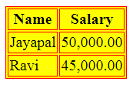
Tables – Backgrounds
Tables Backgrounds
bgcolor attribute − we can set background color for whole table or just for one cell.
background attribute − we can set background image for whole table or just for one cell.
<html>
<head>
<title>HTML Tables</title> </head>
<body>
<table border="1"bgcolor="yellow">
<tr>
<th>Name</th>
<th>Salary</th>
</tr>
<tr>
<td>Jayapal</td>
<td>50,000.00</td>
</tr>
<tr>
<td>Ravi</td>
<td>45,000.00</td>
</tr>
</table>
</body>
</html>

Slide 36
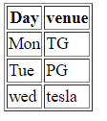
Tables – table body <tbody>
HTML <tbody> tag is used to group the table rows (<tr>) together, which indicates that this is body part of a table (<table>).
The <tbody> tag must be a child of <table> element.
The <tbody> is used along with <thead> and <tfoot> which shows the different part of the table that are table head, table body, and table footer, however, it does not affect the layout of the table.
<!DOCTYPE html>
<html>
<h1>The thead, tbody, and tfoot elements</h1>
<table border="1">
<thead>
<tr>
<th>Day</th>
<th>venue</th>
</tr>
</thead>
<tbody>
<tr>
<td>Mon</td>
<td>TG</td>
</tr>
<tr>
<td>Tue</td>
<td>PG</td>
</tr>
</tbody>
<tfoot>
<tr>
<td>wed</td>
<td>tesla</td>
</tr>
</tfoot>
</table>
</body>
</html>

Slide 37
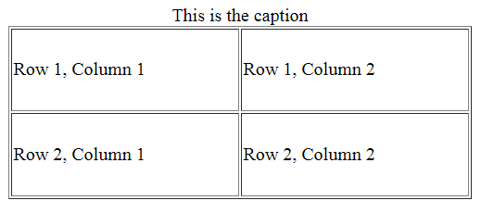
Tables- Height and Width attributes
<html>
<head>
<title>HTML Table Width/Height</title>
</head>
<body>
<table border = "1" width = "400" height = "150">
<caption>This is the caption</caption>
<tr>
<td>Row 1, Column 1</td>
<td>Row 1, Column 2</td>
</tr>
<tr>
<td>Row 2, Column 1</td>
<td>Row 2, Column 2</td>
</tr>
</table>
</body>
</html>
We can set a table width and height using width and height attributes.
Specify table width or height in terms of pixels or in terms of percentage of available screen area.
Table Caption
The caption tag will serve as a title or explanation for the table and it shows up at the top of the table. This tag is deprecated in newer version of HTML/XHTML

